Slide 1
Analysis of Factors Affecting Restaurant Inspection Scores in New York City
PRESENTED BY: JIAYI HUANG, XINYI GUI
Date: Dec 5, 2024
Course: ORCA-E2500

Slide 2
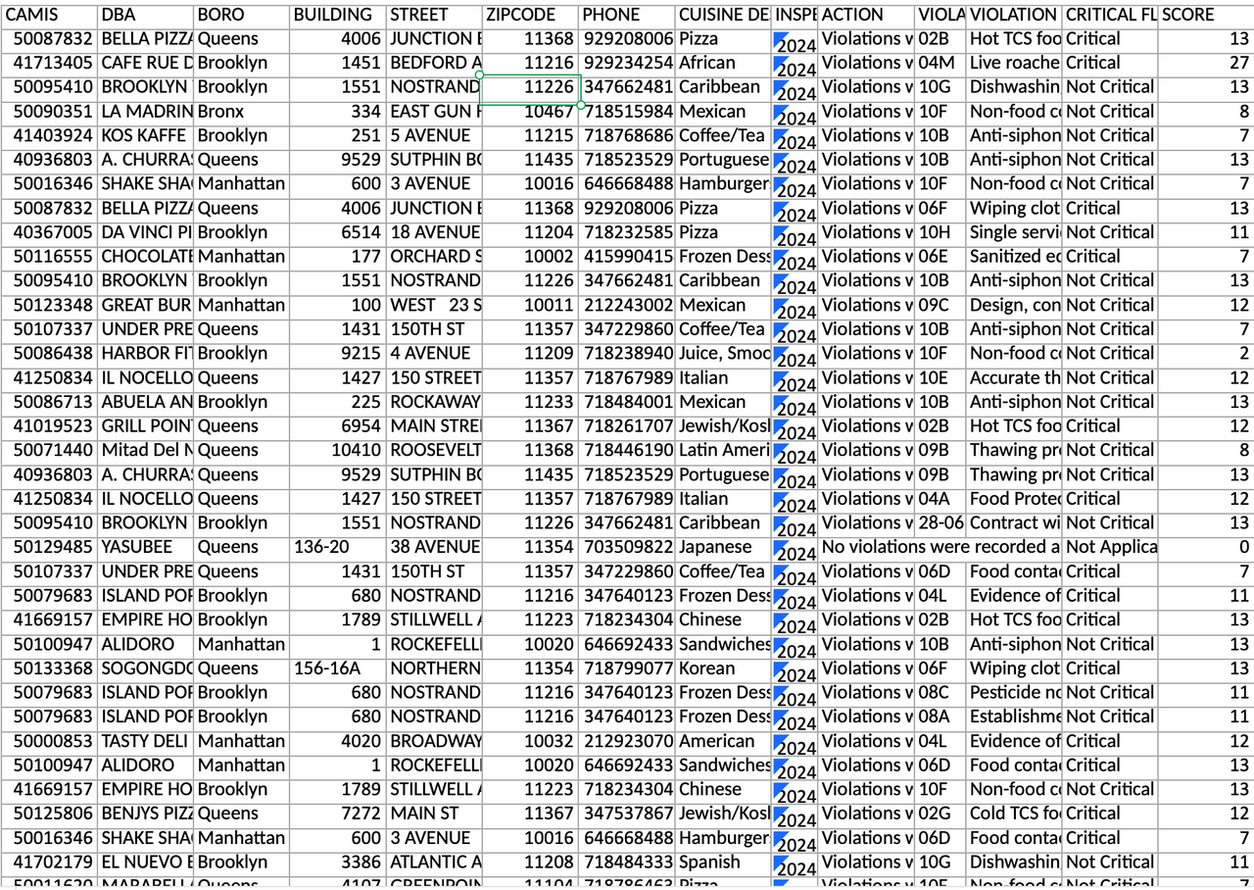
PROJECT OVERVIEW
Objective:
Inspection Scores by Borough and Cuisine
Temporal Trends within the Year 2024
The Factors that lead to Higher Scores
Methodology Summary:
Anova Test
Tukey HSD (Honestly Significant Difference)
Multiple Regression Analysis

Slide 3
DATA SOURCE
Dataset: NYC Restaurant Inspection Results
Source: Department of Health and Mental Hygiene (DOHMH)
Coverage: Inspections up to three years prior to the latest in 2024
Key Variables:
Score: Higher values indicate poorer outcomes.
Borough: Location of the restaurant.
Cuisine Type: e.g., Italian, Chinese.
Inspection Date
Violations: Includes codes and descriptions.
Critical Flag: Indicates critical violations.
Inspection Type: e.g., initial, follow-up.

Slide 4
DATA ACQUISITION AND CLEANING
1.Outlier processing: Outliers were identified using the interquartile range (IQR) method across key variables. Records with operational significance, such as high scores indicative of serious sanitation issues, were retained. Obvious errors were corrected, and robust modeling methods were employed to minimize the impact of extreme values.
2.Feature engineering: Feature engineering played a critical role in enhancing the dataset’s analytical potential. Inspection dates were transformed into month and season categories, enabling the identification of temporal trends. Administrative districts and restaurant types were encoded, and new composite metrics were created. These included the region score difference (BORO_SCORE_DIFF), differences in meal type scores, and trends in average score variations, providing additional context for understanding compliance patterns.
3.Data Standardization: To ensure consistency and comparability, numerical features were normalized, and categorical variables were encoded while maintaining interpretability. These standardization efforts preserved the original data structure while improving its usability for modeling and analysis.

Slide 5
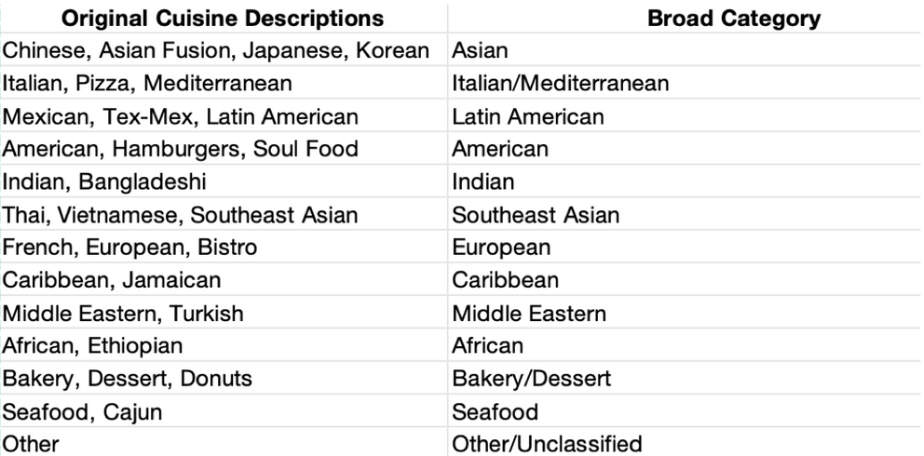

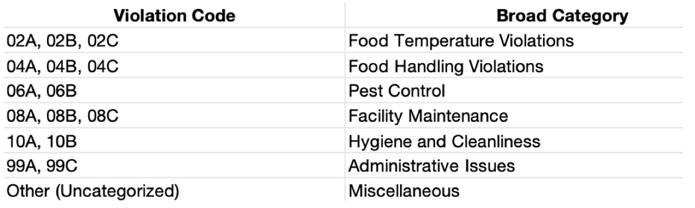
DATA ACQUISITION AND CLEANING
New Cuisine Type Catagories
Violation codes were aggregated into thematic categories reflecting the nature of the compliance issue, allowing for targeted insights into common areas of concern.
New Violation Categories
Cuisine types were grouped into broader categories to facilitate analysis across common culinary practices and regional characteristics

Slide 6
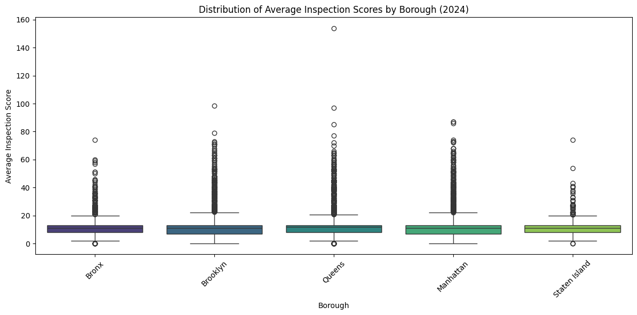
Distribution of Average Inspection Scores by Borough (2024)
Score Distribution Pattern
Borough Characteristics
Median scores: consistent across boroughs (10-15 points)
Score range: majority within 0-40 points
Staten Island: most concentrated distribution
Brooklyn & Queens: wider variations
Manhattan: slightly higher median scores
The Bronx: aligned with city average

Slide 7
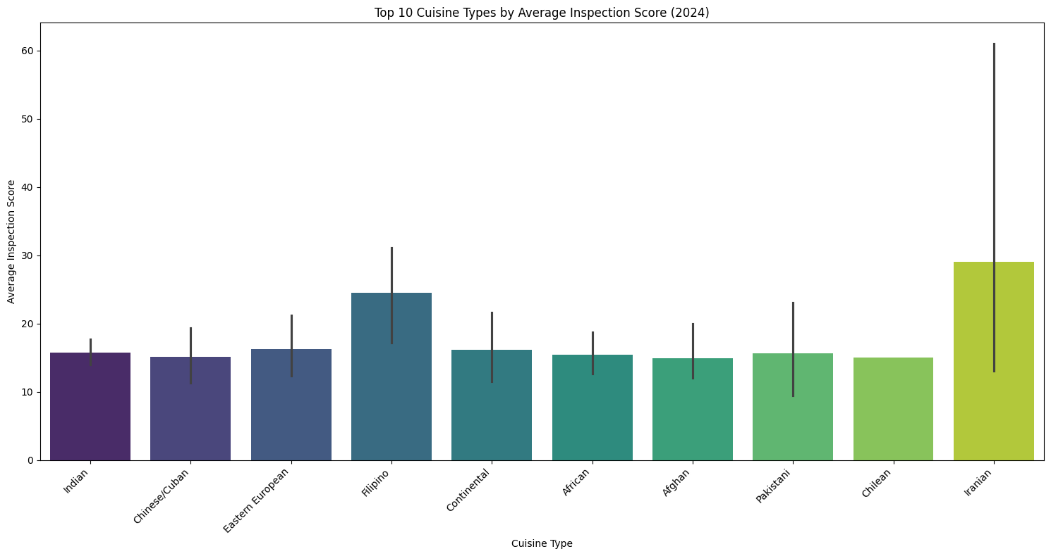
Top 10 Cuisine Types by Average Inspection Score (2024)
Conclusion: Traditional Asian cuisines consistently maintain moderate scores,
while specialty cuisines show higher but more variable performance.

Slide 8
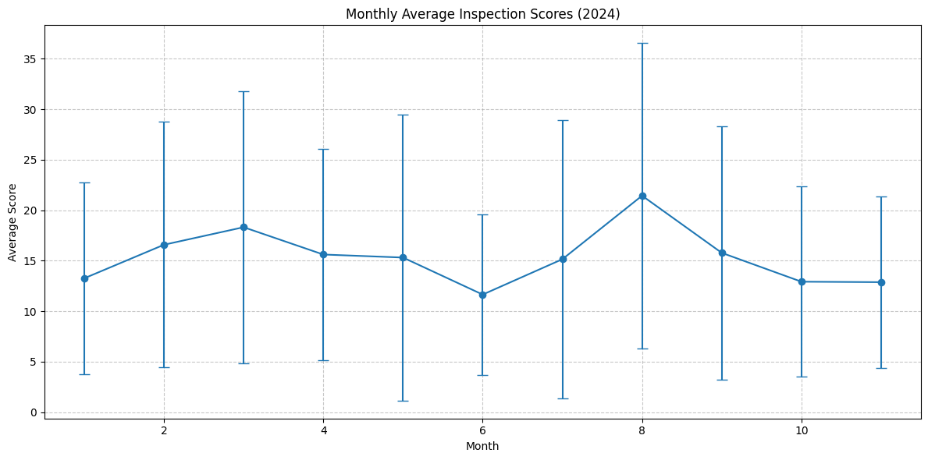
Monthly Average Inspection Scores (2024)
Conclusion: Restaurant inspection scores show clear seasonal patterns, with highest scores in summer months,
suggesting potential impact of seasonal factors on food safety compliance.

Slide 9
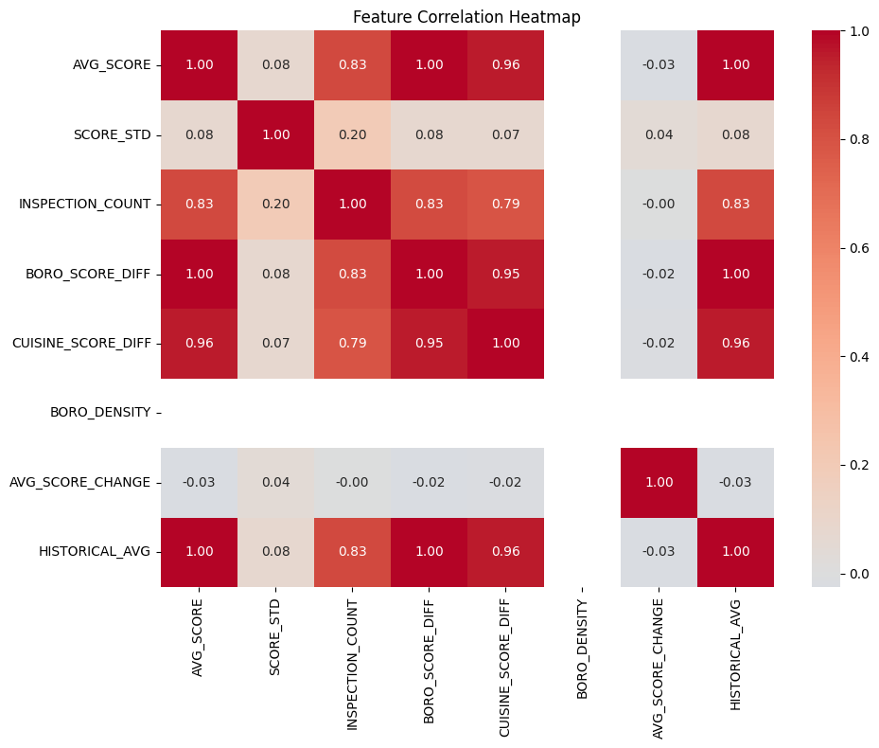
Relationship Between Inspection Count and Average Score (2024)
Higher variability in scores with 4-8 inspections
Queens shows highest single score (~155)
Most restaurants: 2-8 inspections/year
Score spread increases with inspection frequency
Conclusion:
More frequent inspections don't necessarily correlate with higher or lower scores, suggesting inspection frequency may be driven by other factors.

Slide 10
Model Performance Comparison Models Evaluated
Model | Train R² | Test R² | Train RMSE | Test RMSE | CV R² (mean)
Linear Regression | 0.7395 | 0.7364 | 4.4542 | 4.6731 | 0.7397
Ridge Regression | 0.7395 | 0.7363 | 4.4543 | 4.6735 | 0.7397
Lasso Regression | 0.7393 | 0.7361 | 4.4559 | 4.6752 | 0.7396
Random Forest | 0.8706 | 0.8487 | 3.1401 | 3.5405 | 0.8386
Random Forest is the optimal choice for this prediction task, demonstrating:
15% better prediction accuracy than linear models
24% lower prediction error
Robust performance across cross-validation
No significant overfitting (Train-Test gap: 0.022)

Slide 11
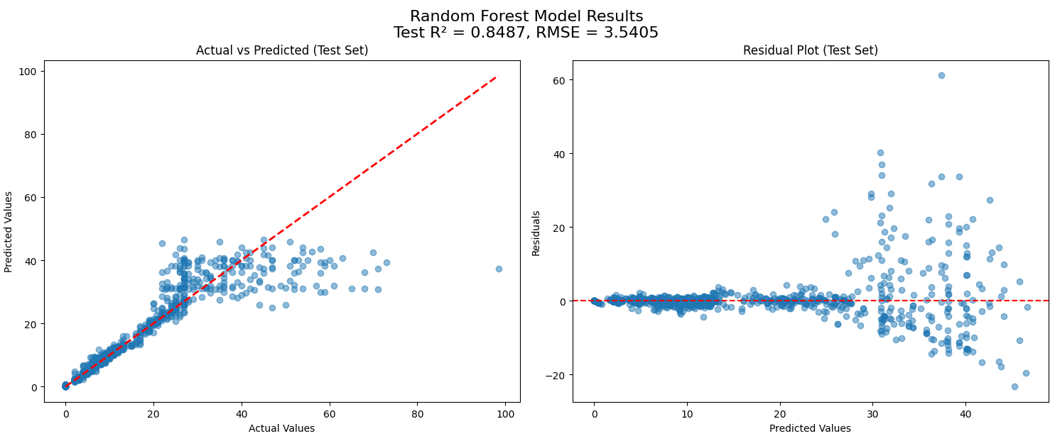
Random Forest Model Deep Dive Model Configuration
Optimal Hyperparameters:
Trees in forest: 200
Maximum depth: 10
Minimum samples for split: 5
Accuracy Metrics
R² Score Training: 0.871
Test: 0.849
Shows strong predictive power with
minimal overfitting
Error Metrics
RMSE
Training: 3.14
Test: 3.54
MAE
Training: 0.84
Test: 1.01

